Slide 1
D.A. Meeting IS Agenda
09:15-09:20 ABS and Intranet/Public Drive
New Unit Numbering System
Paying Of Mechanics In ABS
MTSs
ET1/EIT Bonuses
Different Versions Of Forms On The Intranet vs. The Public Drive
Any Other Related Issues
09:20-09:50 PIP Feedback/Questions/Answers
09:50-10:20 E-Service System Overview
10:20-10:45 General Questions and Issues

Slide 2
ABS and Intranet/Public Drive

Slide 3
PIP Feedback/Questions/Answers

Slide 4
E-Service System Overview

Slide 5
E-Service System
The goal of the system is to improve the process used by Sanjel Corporation and Sanjel (USA) Inc. to generate and track all artifacts related to a Job by getting the Job’s data to Sanjel Head Office (HO) in a timely and accurate manner. The system will provide the infrastructure needed to electronically send and receive Job artifacts between the Field and HO. The system will be constructed with the following key attributes: maintainability, scalability, simplicity, and usability.
Job Artifacts
A Job is the collection of many artifacts including: Program, Call Sheet, Service Ticket, Service Report, and Job Incident etc.

Slide 6
System Main Business Functionalities and Scope:
Generate, capture, transfer, and store all in-house Artifacts electronically as structured data in the corporate database.
Transfer and store all third party Artifacts electronically as unstructured data in the corporate database.
Workflow and tracking per Job.

Slide 7

Call
Sheet
@ 08:00
Husky
Phone
Coordinator
Create
Call
Sheet
@ 09:00
Save to local
Supervisor
Service
Ticket
Service
Report
@ 16:00
+
Create from Call Sheet
Supervisor
Service
Ticket
Service
Report
Third Party
Files
@ 17:00
+
+
Send to HO
Supervisor

Slide 8
E-Service System Modules:
  Core Module: the functionalities needed to generate the following artifacts electronically in the District or Field: Call Sheet, Service Ticket, and Service Report. In addition to sending the artifacts back to Head Office. A Pilot release of this module is schedule for May-June 2006.
  Job Incident Module: store all data related to a Job Incident for reporting. A Pilot release of this module is in use by Safety and Pumping Services Operations.
  Uploader Module: transfer all third party generated files to Oracle. A Pilot release of this module is schedule for November 2006.
  Workflow Module: automating the process of approving a Job Artifact.

Slide 9
E-Service Is Not:
  Replacing the Books.
  Built only by IS.
  Delivered after gathering 100% of the requirement.
  A solution to all problems.
  A system who’s value can only be measured with money.

Slide 10
Building E-Service:
  Simplicity is key.
  Getting the users involved and building a relationship.
  User feedback is driving the implementation order and iterative releases.
  Upgrading existing infrastructure.
  Price Book and Data Hand Book.
  New Technologies: .NET, Service Oriented Architecture (SOA), and C# etc.
  Competitors tools and third party options.
  We have been working closely with all Service Lines Managers and visiting the Districts to get feedback.
  Module Driven Development and Deployment.

Slide 11
Assumptions:
  One Workstation per Field Coordinator.
  One Workstation per District Service Line Manager.
  A minimum of one Laptop capable of capturing signatures on each Job with 1X connectivity and a printer.
  The system will only be installed and accessed through Sanjel’s hardware.
  Each user must have a Sanjel NT username and password to be able to use the system.

Slide 12
Effect On The DA's Daily Workflow:
  Phase One: there will be no appreciable differences as the normal approval process and ABS will be the same as before. The only difference will be in the look and feel of the printed documents returned from the field.

Slide 13
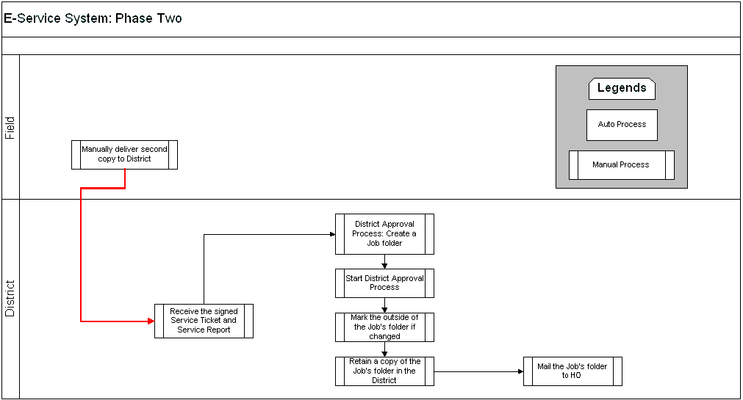
Effect On The DA's Daily Workflow:
  Phase Two:

Slide 14
E-Service System
Q/A

Slide 15
General Questions and Issues

